Slide 1

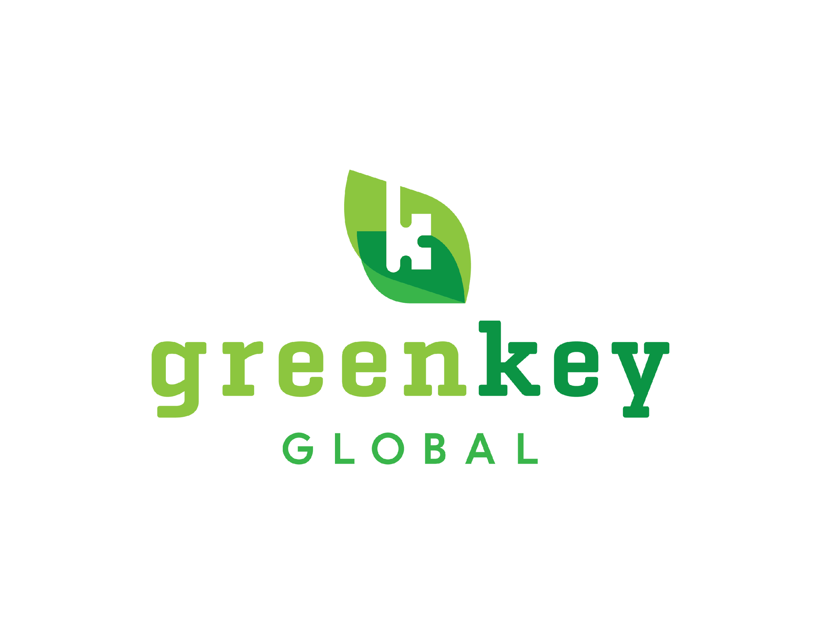
A Hotel's Roadmap to
Eco-Rating Certification
The Leading North American Standard in Sustainable Hospitality Certification
For hotel leadership and management company operations teams | Last Updated: July 2026
GREENKEYGLOBAL.COM
Notes:
Open with the audience's world: every hotel in the portfolio is already being asked about sustainability by a buyer, an OTA, a brand, or an owner. This deck shows how Eco-Rating turns that question into won business, and how a portfolio partnership makes it easy.

Slide 2




THE STARTING POINT
Every hotel gets asked the same question
Corporate RFPs
Booking platforms
Brand standards
The utility line
Travel buyers ask for recognized certification before shortlisting your property
OTAs ask for third-party verification before showing a sustainability badge
Flags are adding certification to brand requirements
Owners ask why energy, water, and waste costs keep climbing
It is always the same question underneath: can this hotel prove, credibly, how it operates?
Notes:
Whatever market a property is in, one of these four is already on the GM's desk. Certification answers all four with one credential.

Slide 3
WHY GREEN KEY
The credibility, the demand, and the commercial evidence behind the leading North American standard.
Notes:
Phase framing borrowed from the partnership playbook: give the audience a map of the conversation.

Slide 4
WHO WE ARE
Built by hoteliers, for hoteliers
1993
2024
3,000+
13,000+
founded by the Hotel
Association of Canada
joint venture of AHLA
and Hotels Canada
certified properties
across North America
trees planted, one for
every new member
We certify operations, not construction. Unlike building certifications, Eco-Rating measures how a hotel runs: daily practice, procurement, waste, water, energy, and people. A 1970s roadside property and a new-build lifestyle hotel compete on the same terms.
No capital spend is required to certify. The assessment scores what a property already does and recommends improvement over time. Sections that do not apply (F&B, Conference) opt out with no scoring penalty.
Tree planting in partnership with One Tree Planted (onetreeplanted.org).
Notes:
The industry asked AHLA for one trusted certification rather than another framework. AHLA joined the program with the 30-year track record.

Slide 5
THE DEMAND
Documented by independent industry research
What this means on property
RFP eligibility for corporate and group business
Sustainability badges on the OTAs where guests book
A credible answer for owners, brands, and planners
Sources: Expedia Group, Sustainable Travel Study (2022); Booking.com, Sustainable Travel Report (2021); GBTA Foundation, The State of Climate Action in Business Travel (2023).
Notes:
Independent studies, not our numbers. The demand signal shows up in every segment, leisure OTA traffic through managed corporate travel.

Slide 6
THE COMMERCIAL EVIDENCE
Certified hotels win more corporate business
3x
the corporate room nights at certified hotels: 622 per year versus 202 at non-certified
97% vs 70%
certified hotels that won corporate business, versus non-certified
Source: Alō Index, analysis of 5,082 assessed hotels, 2025 full year. Green Key Global partnered with the Alō Index in 2026.
Notes:
The newest, most commercial evidence: certification drives business. Our 2026 Alō partnership feeds certified properties into corporate travel visibility.

Slide 7




A RECOGNIZED STANDARD
The answers when a buyer or regulator asks "says who?"
United Nations SDGs
Aligned with all 17 Sustainable Development Goals, the shared vocabulary of corporate sustainability
GSTC-Recognized
Standard recognized by the Global Sustainable Tourism Council
Travalyst
Recognized by the coalition behind sustainability labels on major booking platforms
ISO-aligned, EU-ready
Certification structured around ISO/IEC 17065; compliant architecture for the EU green-claims directive in force September 2026
Sources: United Nations 2030 Agenda (2015); Global Sustainable Tourism Council, gstc.org; Travalyst, travalyst.org/industry; Directive (EU) 2024/825.
Notes:
EU point matters even domestically: it is where green-claims rules are heading, and our compliance and revocation architecture already meets it.

Slide 8
THE TRAJECTORY
The entire industry is converging on independent certification
WTTC
EU regulation
Owners' advisors
The World Travel & Tourism Council is elevating Hotel Sustainability Basics, adopted by 8,000+ hotels in 85 countries, into an independent third-party certification scheme.
The Empowering Consumers for the Green Transition Directive takes force September 2026: sustainability labels shown to EU travelers require independent verification.
JLL: hotels that embed sustainability into capital planning see lower operating costs, green financing access, brand equity, and lower regulatory risk.
WTTC, 25 June 2026
Directive (EU) 2024/825
JLL, November 2025
Eco-Rating is this model, built for North America, with a two-decade head start with the buyers who matter here.
Notes:
Not a bet on a trend: regulators, the global industry body, and owners' advisors are moving to the same model. Early movers get the market benefit; late movers get a compliance cost.

Slide 9
HOW CERTIFICATION WORKS
The assessment, the 37 Core Criteria, the independent audit, and what it costs.

Slide 10





INSIDE THE ASSESSMENT
Organized the way a hotel actually runs
Corporate Management
Housekeeping
Engineering
Food & Beverage
Conference & Meetings
Policy, action plan, purchasing, Green Team, engagement
Linen reuse, products, room routines, training
Utility tracking, maintenance, HVAC, lighting, waste
Purchasing, food waste, refrigeration, service
Event-space sustainability practices
All properties
All properties
All properties
Optional
Optional
200+ questions, multiple users, save as you go, templates for every required document, and evidence uploaded against each mandatory answer so the audit verifies proof, not promises. Opted-out sections rescale the score with no penalty.
Notes:
Department-based structure: each section lands with the person who already owns the answers. Nothing lands on a sustainability specialist you do not have.

Slide 11

THE 37 CORE CRITERIA
A clear, credible front door to a first Key
Govern it. Signed policy, named accountable manager, action plan
~11 days
Staff and train it. Green Team meeting quarterly; housekeeping routines trained
average completion, down from ~80
37
of 200+ questions
Measure it. 12 months of utility data; written preventative maintenance
4-6 hrs
Prove it. Evidence uploaded for every mandatory answer; templates provided
of focused work for the Core assessment
Source: Green Key Global Eco-Rating program data, 2026. A "Display Core Criteria Only" filter isolates the 37 questions in the assessment portal.
Notes:
Meeting the 37 earns a first Key and audit eligibility; everything beyond is climbing. Not chosen to be easy, chosen to be foundational.

Slide 12
HOW IT WORKS
Self-paced up front, rigorous at the back
1
2
3
4
5
Assess
Evaluate
Audit
Certify
Market
→
→
→
→
Online self-assessment, multiple users, save as you go
Preliminary rating and gap scorecard; retake freely
Independent verification by Control Union
1 to 5 Keys, valid three years, performance report
Toolkit, OTA badges, RFP content, plaque
Impartial by design. We set the standard but never audit our own members. Audits are conducted by Control Union, an independent global inspection firm, and the certification decision rests with an independent Certification Body, per ISO/IEC 17065. Audits typically commence within ~90 days of request.
Notes:
This answers the credibility question before it is asked: a label the issuer can never take away is not a certification.

Slide 13
THE RATING
One standard, five levels, room to grow for a decade
Any rating is full certification. A first Key requires all 37 Core Criteria. The Property Performance Report shows exactly where the points for the next Key live.
1 Key
2 Keys
3 Keys
4 Keys
5 Keys
1-19%
20-39.9%
40-59.9%
60-79.9%
80-100%
of available assessment points
Notes:
Economy properties certify honestly at 1 Key and climb; a flagship pursues 4 or 5. The performance report makes the climb a capital-planning tool: spend where it pays twice, in utilities and in rating.

Slide 14
THE INVESTMENT
Priced for every tier of the market
Published pricing (July 2026) | United States | Canada
Annual membership, per property | $750 / year | $950 CAD / year
Virtual audit, once per 3-year cycle | $500 | $500
On-site audit (optional alternative) | $2,500* | $2,500*
<$80/month
full 3-year U.S. cycle: $2,750 all-in with a virtual audit
*Travel dependent. Fees reviewed periodically; current pricing at greenkeyglobal.com. Partnership pricing available (next section).
3 bookings
The practices the assessment rewards (utility tracking, preventative maintenance, linen reuse, right-sized purchasing) are the same practices that cut operating cost.
in a year covers the cost of certification; the rest is return
Notes:
Anchor against outcomes: one RFP won, one OTA booking lift, or a small utility reduction each independently outruns the fee.

Slide 15
PARTNERING WITH GREEN KEY
For brands and management companies: membership commitment in exchange for preferred pricing and dedicated support.
Notes:
This section is informed by our Partnership Development Playbook: the value exchange, the onboarding experience, and the ongoing account management a partner receives.

Slide 16





THE PORTFOLIO ADVANTAGE
What a formal partnership includes
Preferred pricing
Dedicated Account Manager
Structured activation
A formal membership commitment across your portfolio in exchange for discounted certification fees under an MSA or MOU
A named owner of your partnership from activation onward: rollout support, troubleshooting, and best-practice guidance
A joint kickoff with your team, a year-one engagement plan, promo codes, and enrollment workflows configured for your properties
Co-marketing launch
Quarterly reporting
Fast-track equivalencies
A joint launch plan with agreed messaging across PR, web, social, and email, supported by our templates
Partnership progress reports tracking certification, participation, and impact against agreed targets
Where a brand program equivalency exists, work your properties have already done is credited toward certification
If your flags or group already hold an agreement with us, your properties may have simplified enrollment waiting. Ask before enrolling individually.
Notes:
Directly from our partnership model: commitment in exchange for discount, a named Account Manager after handoff from the sales team, an activation meeting with marketing present, promo codes for enrollment, and quarterly and annual progress reports. Destinations increasingly sponsor certification too.

Slide 17
THE PARTNERSHIP JOURNEY
From first conversation to renewal
1
2
3
4
Explore & Agree
Onboard
Execute
Grow & Renew
Discovery of your portfolio goals and timelines
Tailored proposal and term sheet
MSA or MOU with negotiated rates
Activation meeting with your team
Dedicated Account Manager assigned
Promo codes, workflows, co-marketing launch
Property rollout and certification support
Best-practice guidance on demand
Quarterly and annual progress reports
Annual review against agreed targets
Expansion across the portfolio
Renewal on proven results
→
→
→
Structured as a formal commitment to Green Key membership in exchange for preferred certification pricing and dedicated support.
Notes:
This mirrors the phases our own team runs internally: partnership sales, onboarding and initiation, execution, and closing and renewal. What the partner experiences is a managed, predictable journey with clear ownership at every phase.

Slide 18

AFTER CERTIFICATION
The credential goes to work immediately
Marketing Toolkit
Automatic distribution
Performance Report
Vendor Directory
Logos, website copy, in-room and event collateral, RFP response content, staff checklists
Certified-property lists shared with OTAs, procurement officers, and RFP platforms
Property-specific roadmap showing where the points for the next Key live
75+ vetted sustainability suppliers with exclusive member discounts; strictly vendor-agnostic
Claims-use rules protect the mark: certified members may use the Green Key name and rating only while current and in scope. That discipline is what keeps the badge worth displaying.
Notes:
Distribution is automated: travelers and planners see certified properties on the channels where they already book.

Slide 19
Run well. Prove it.
Be recognized for it.
A standard hoteliers built, verified by an auditor no one can lean on, at a price every tier can carry.
1
Check for an existing agreement Your brand or management group may already hold partnership terms and fast-track pathways
2
Pick a pilot cohort Mirror your real portfolio: urban and rural, full- and select-service; 90 days per property
3
Start the Core Criteria Name the accountable officer, form the Green Team, pull 12 months of utility bills, and begin
greenkeyglobal.com | info@greenkeyglobal.com
GREENKEYGLOBAL.COM
Notes:
Close with the ask: a portfolio conversation, not property-by-property signup. Leave behind the executive brief; offer the full report for the operations team.

